Slide 1

By Farzaneh Faramarzi Professor Seeger
Final Project for LA-558
Spring 2023

Slide 2
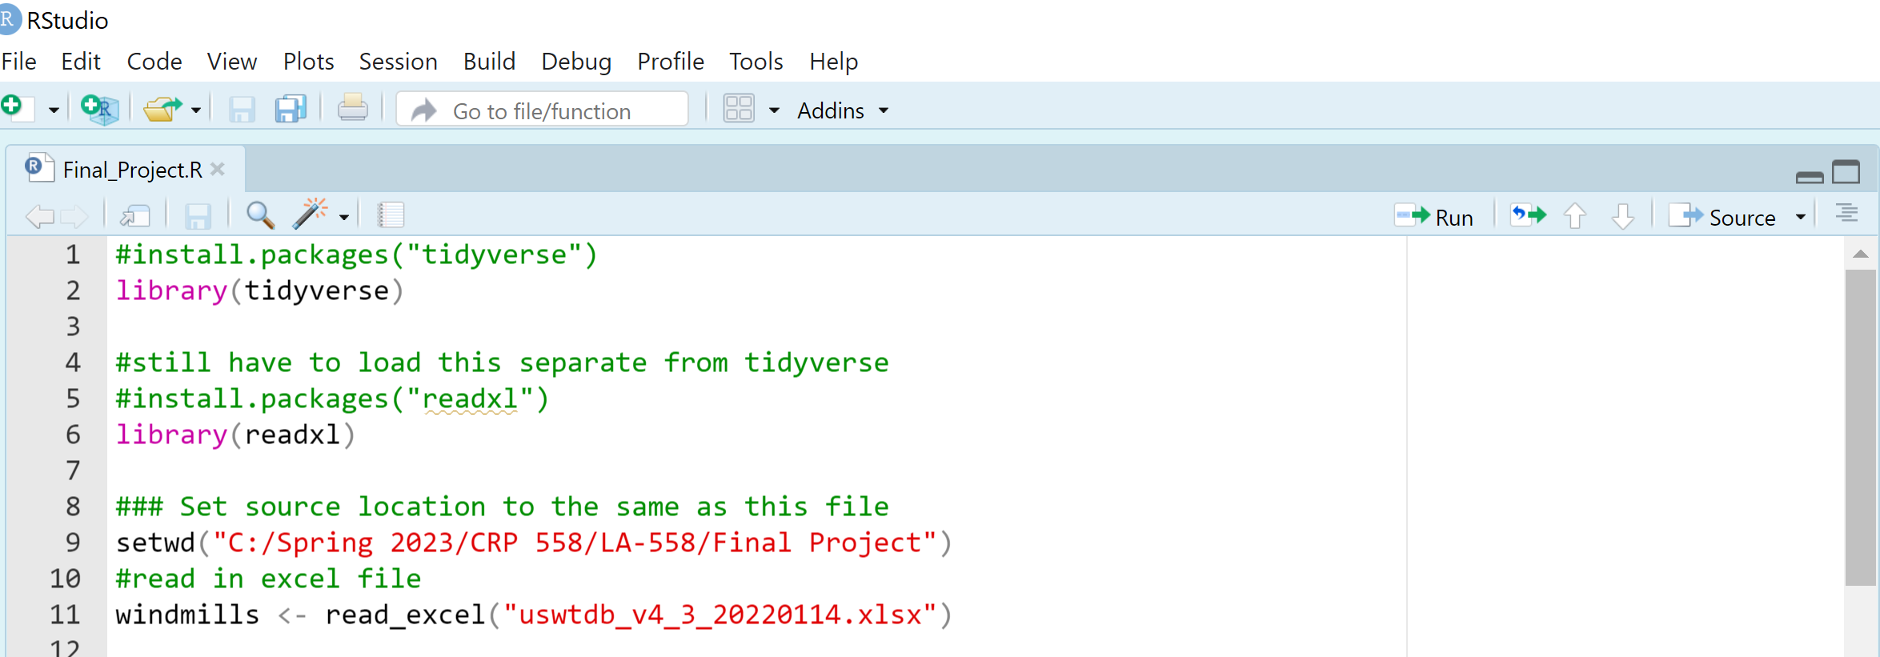
Read the Data in R

Slide 3
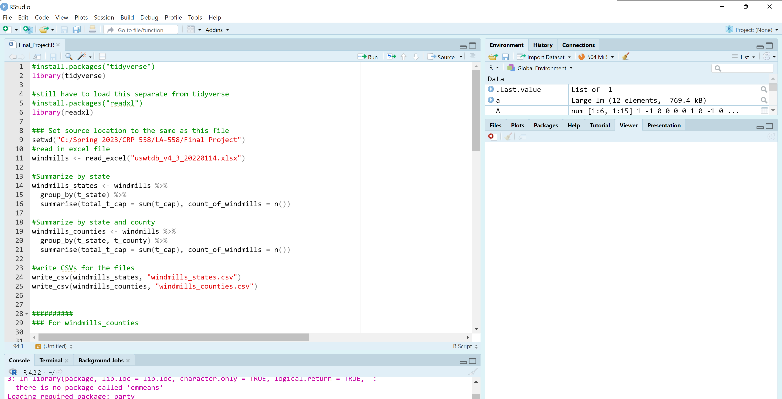
Clean the Data

Slide 4
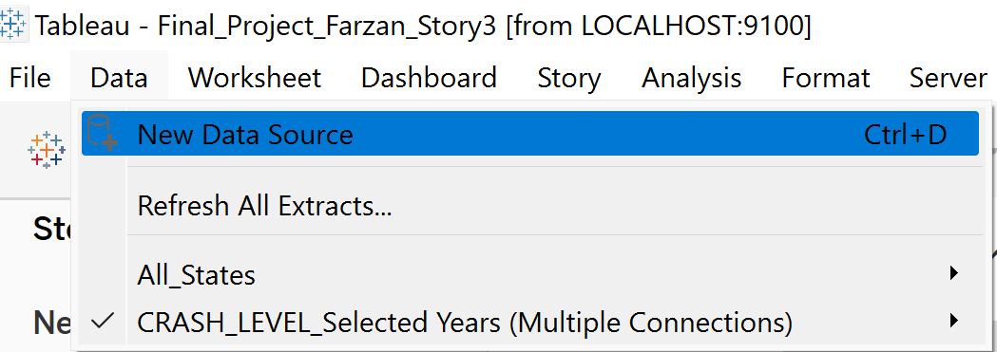
Read the Data in Tablue that in R we Cleaned Before

Slide 5
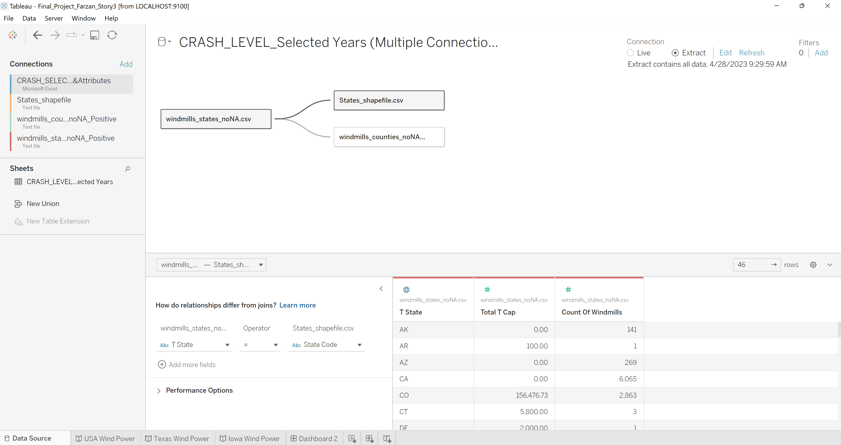
Connect Different Data together

Slide 6
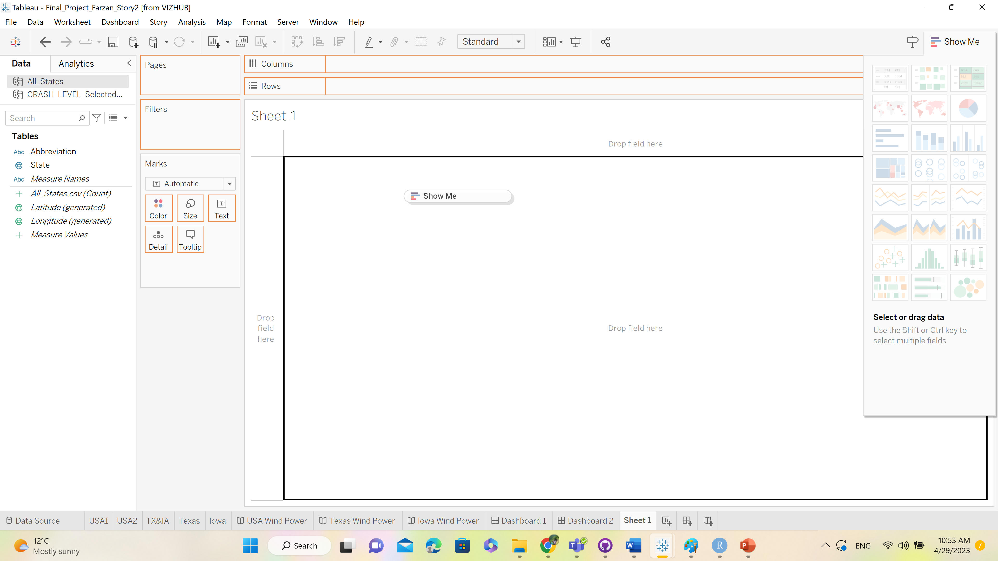
Pull the Global Data to the

Slide 7
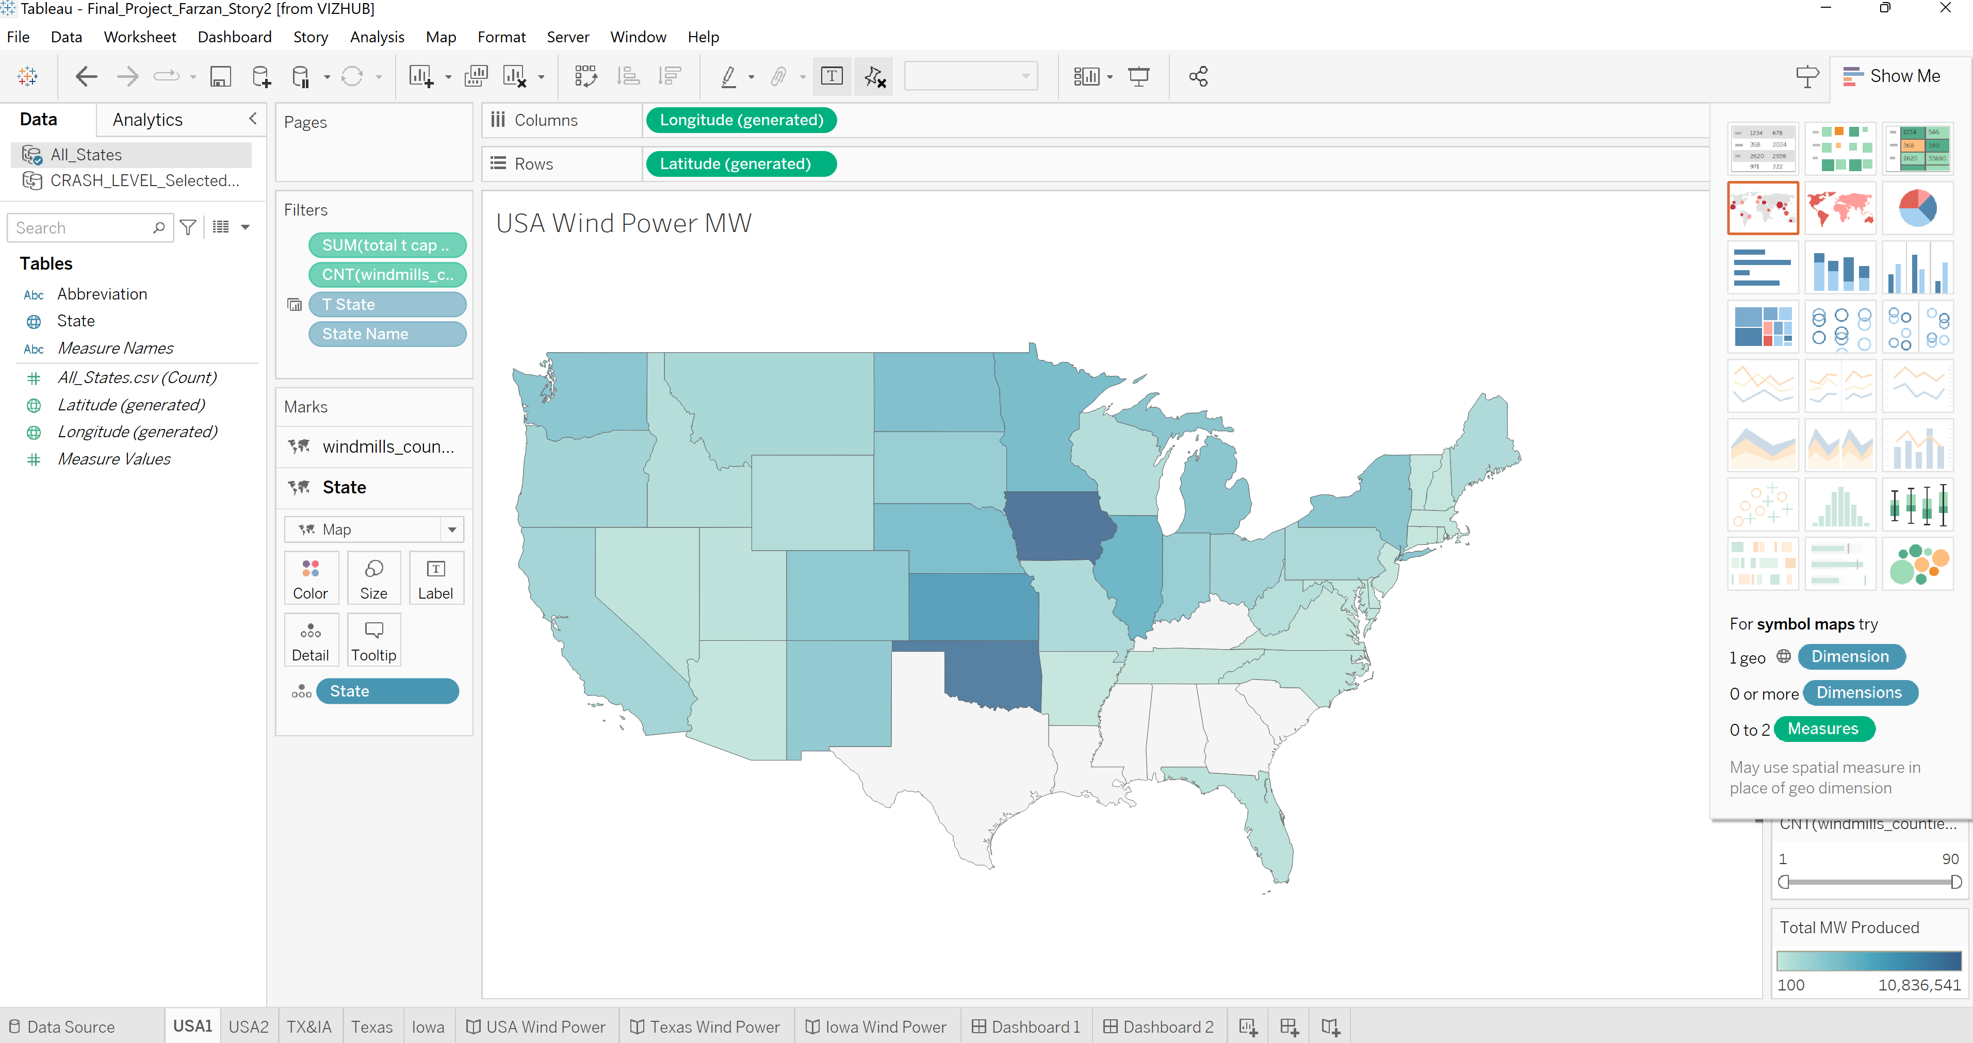
Add Label and Details and Edit the Sheet Name

Slide 8
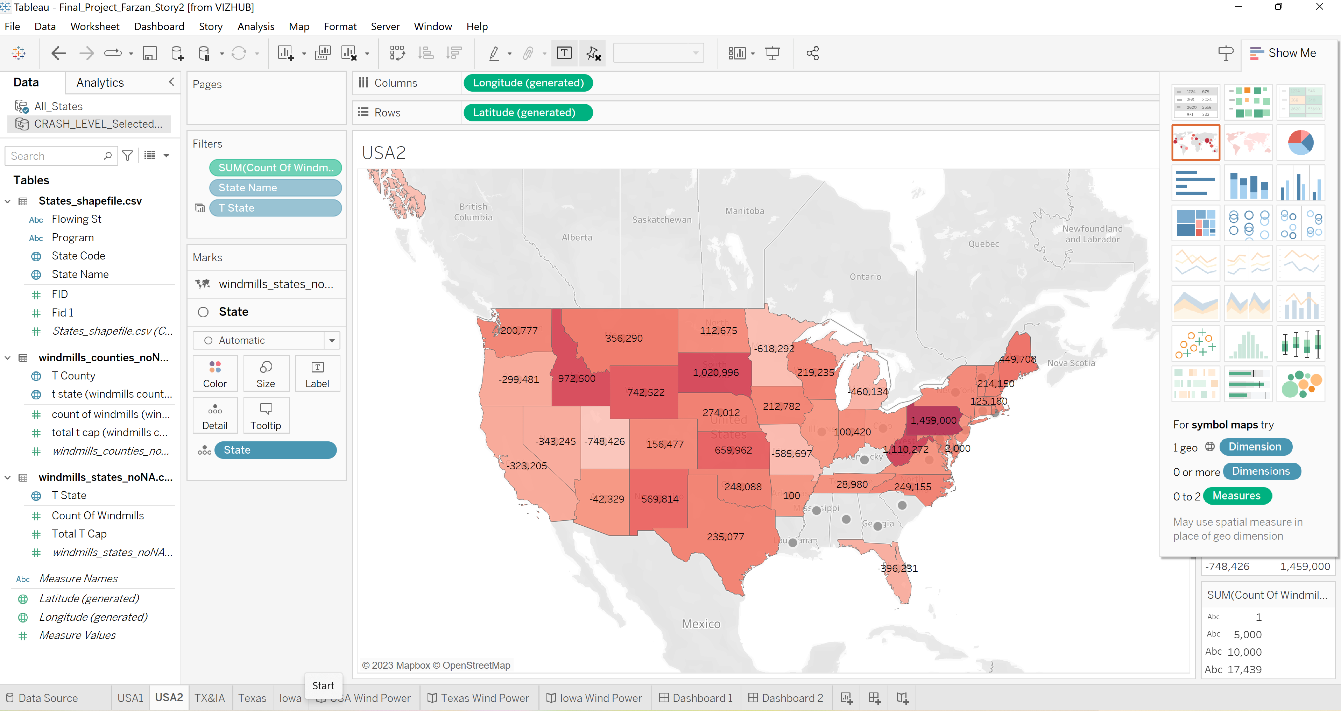
Add Other Sheets and Do the Similar Process

Slide 9
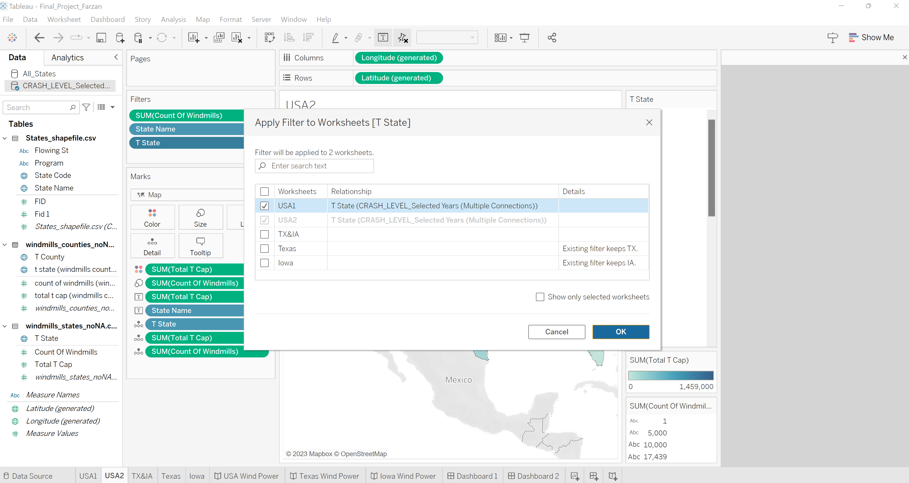
TO make the filter same in two maps

Slide 10
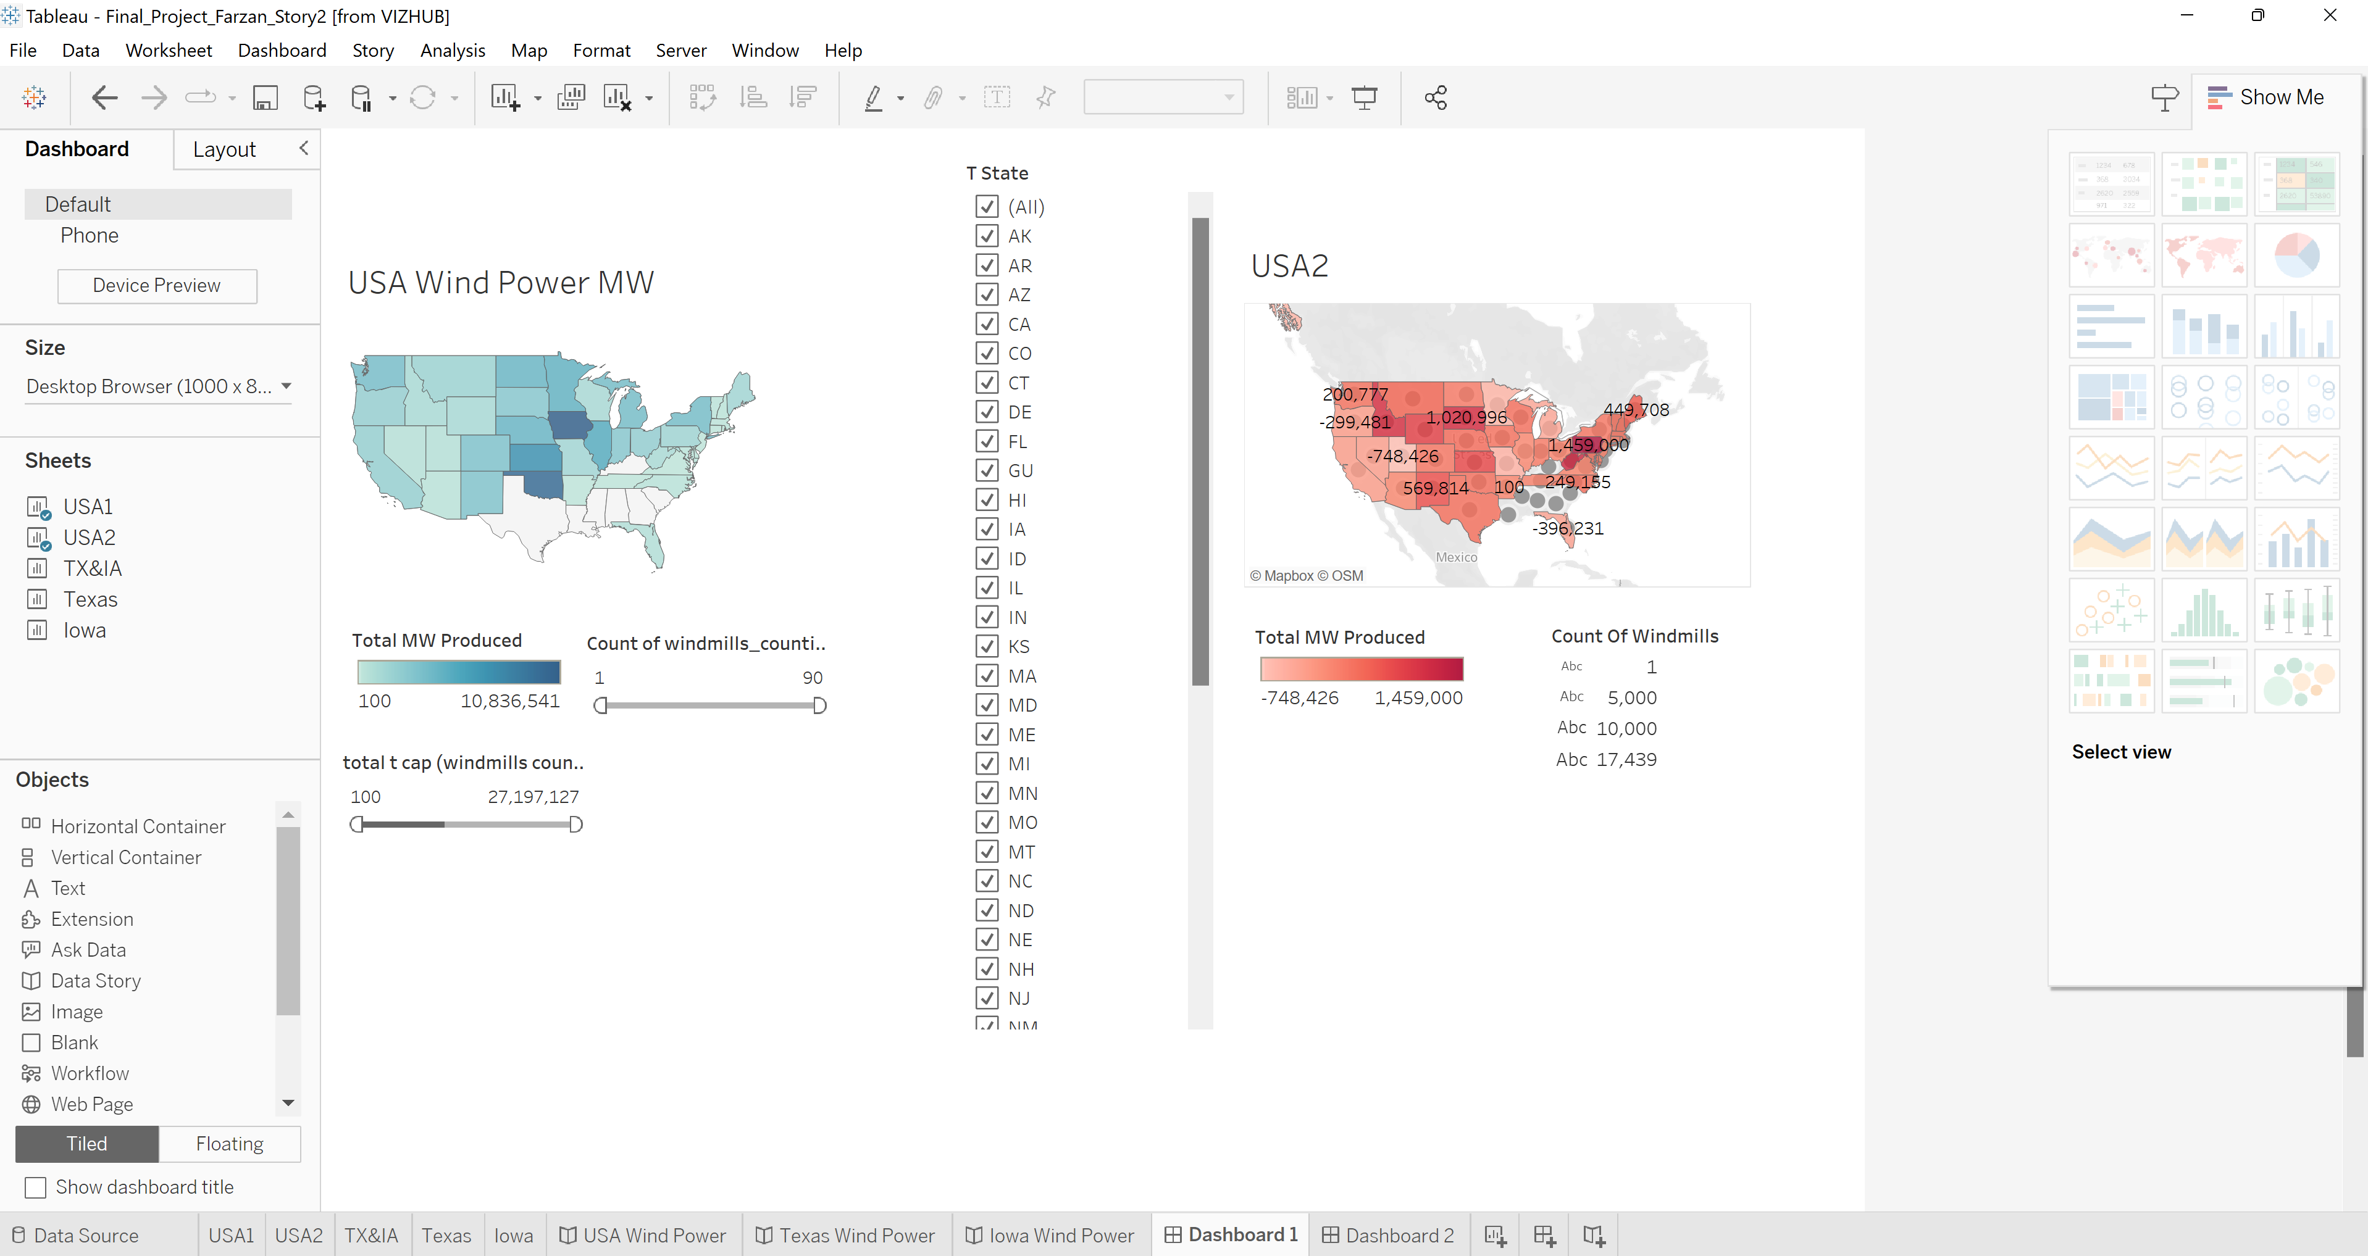
Add a Dashboard and Add Related Sheets in it
I Prefer to work on Floating tab than Tiled. Floating gives flexibility to edit the size and location of map in the page.

Slide 11
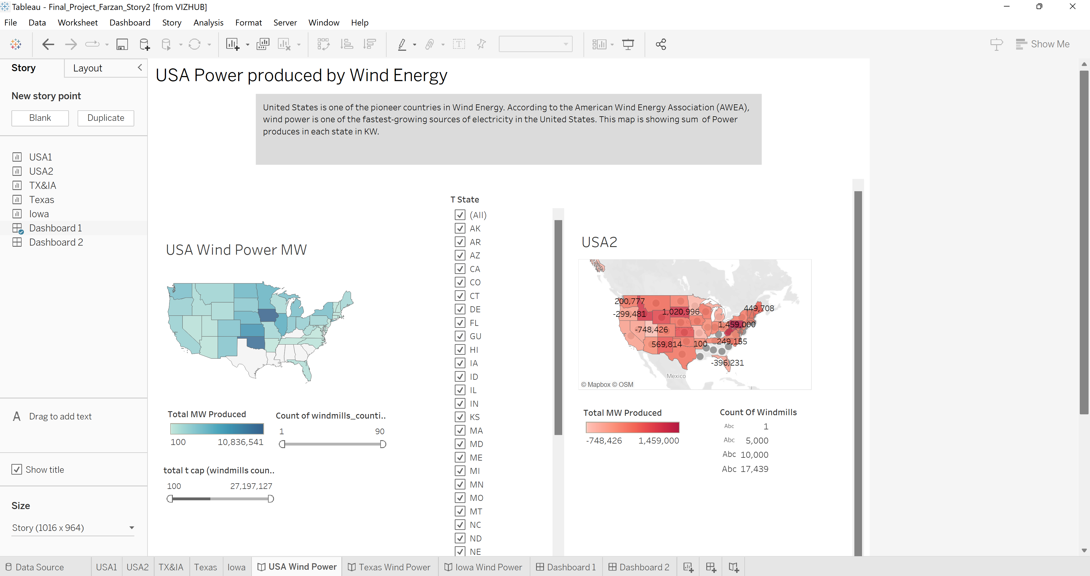
Add Story and Write the Lit Review in the Box

Slide 12
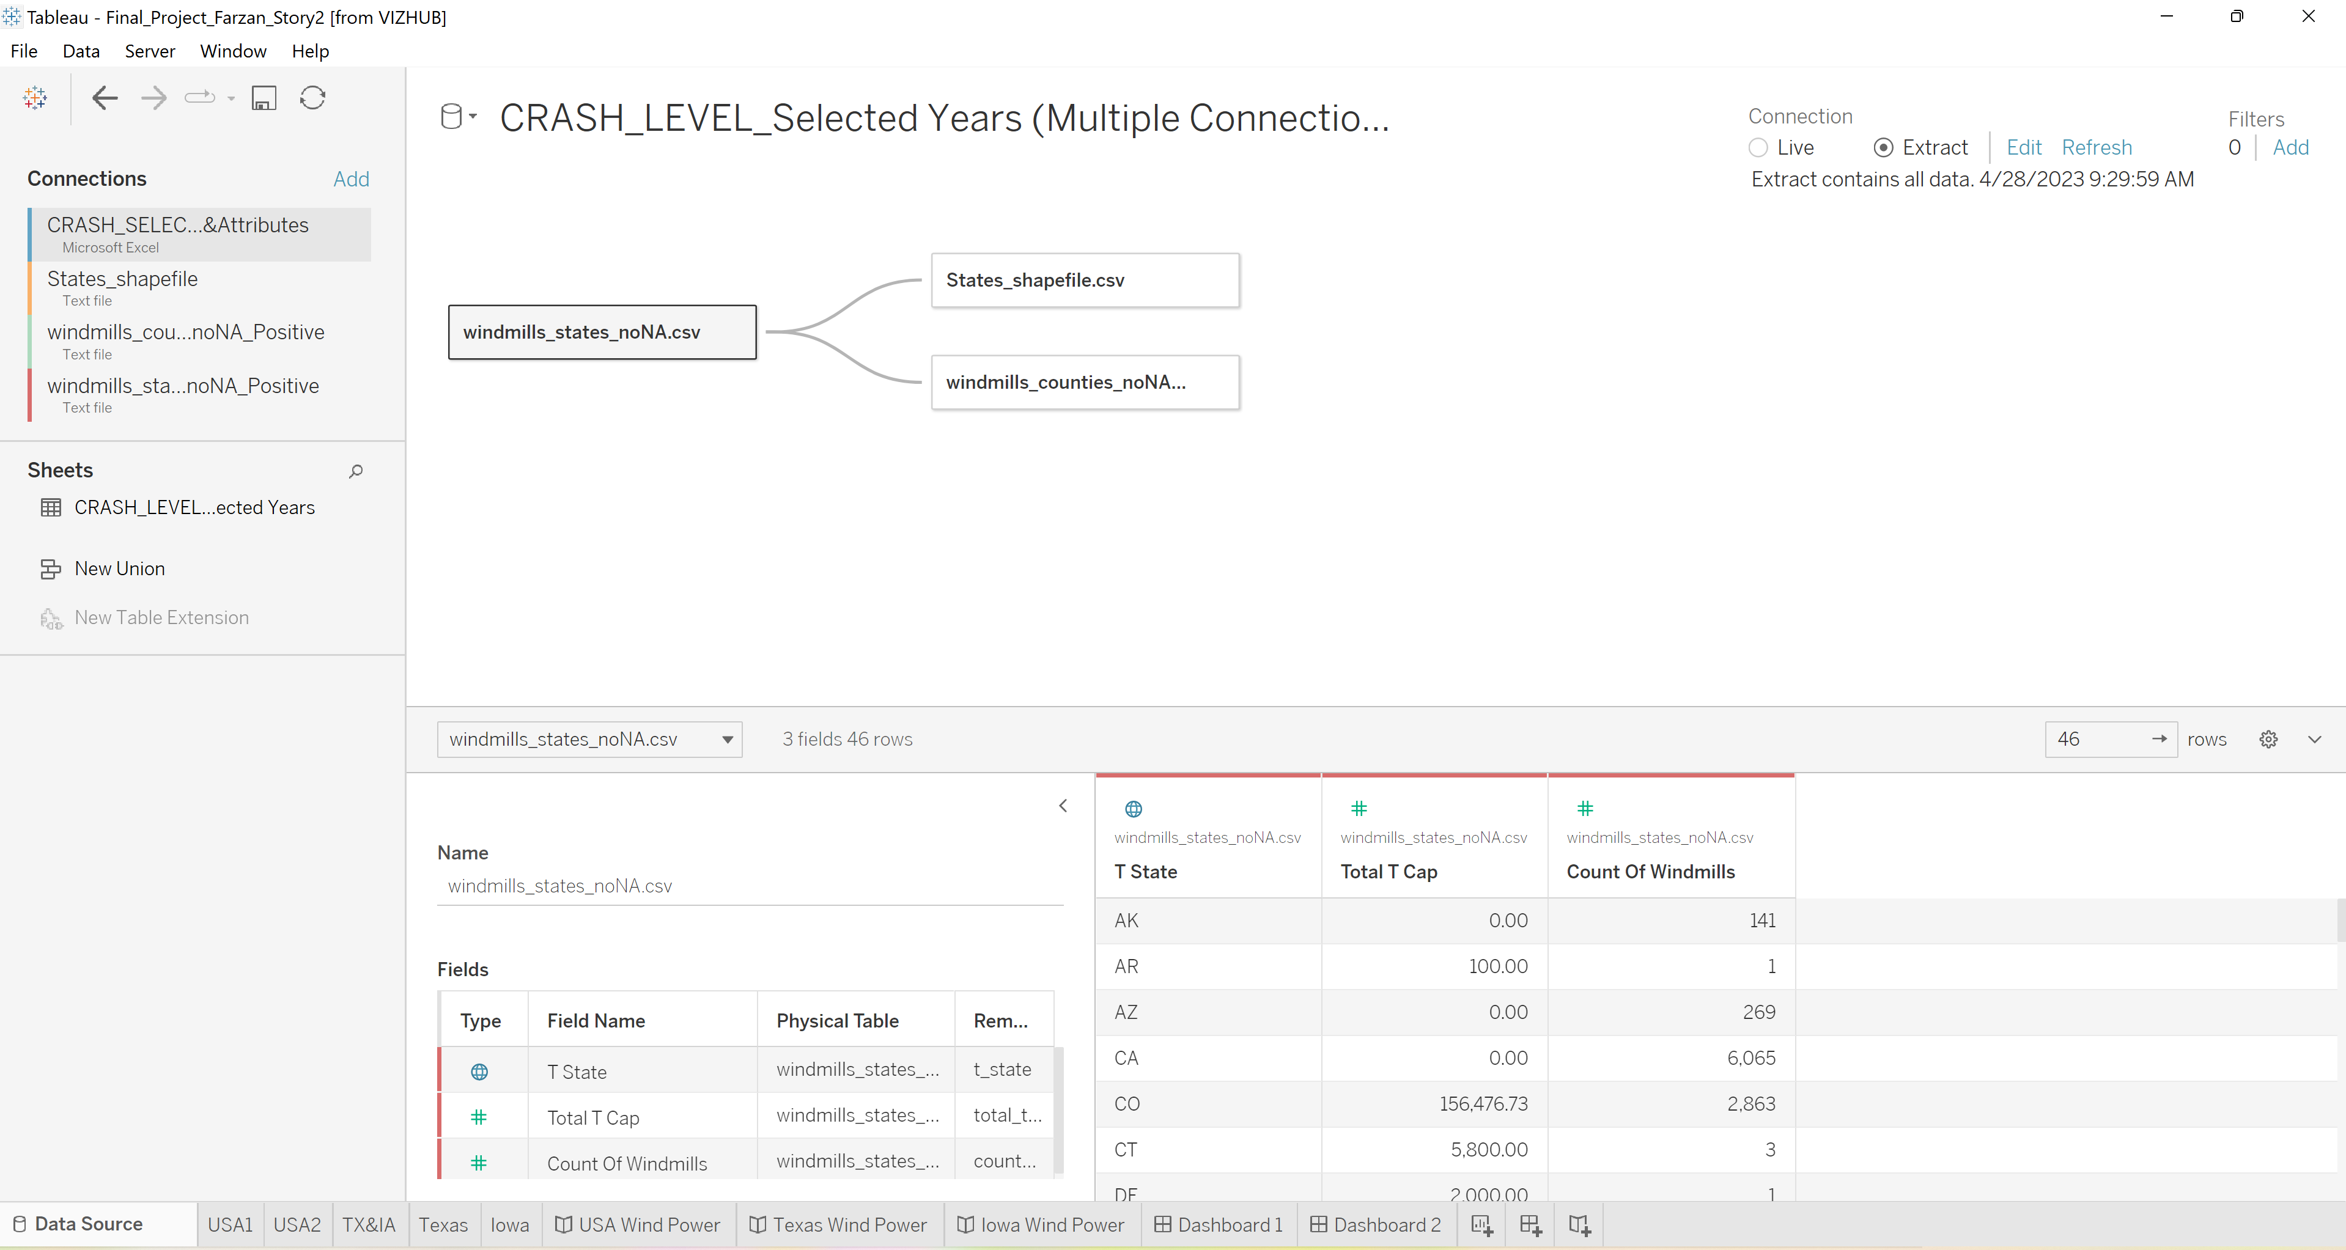
Extract the Data to ba Able to Share in Tableu

Slide 13
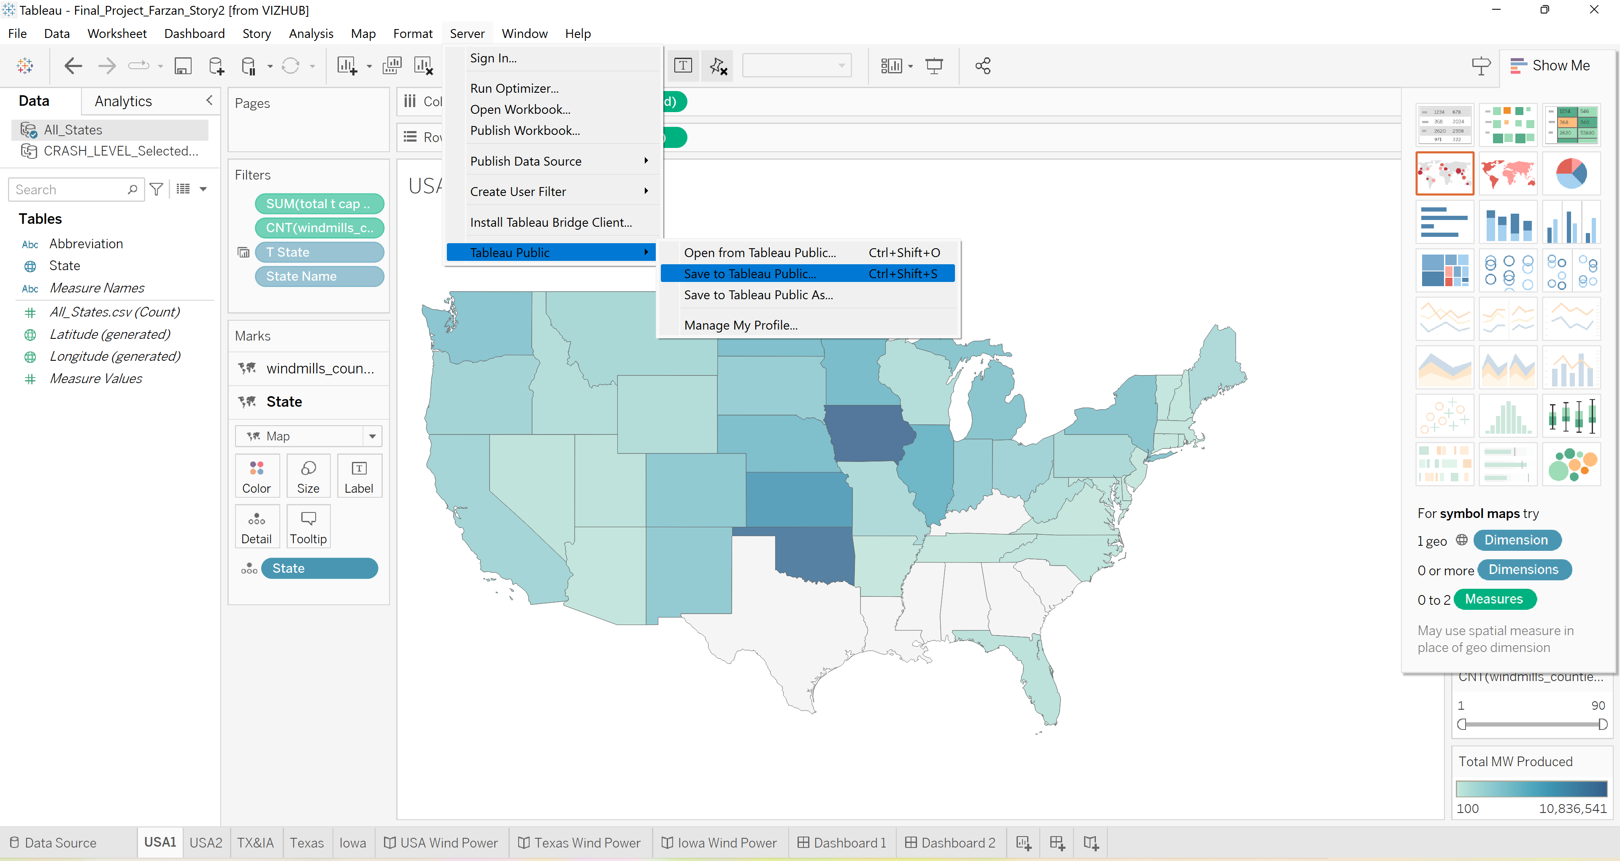
Share in Tableu Public

Slide 14
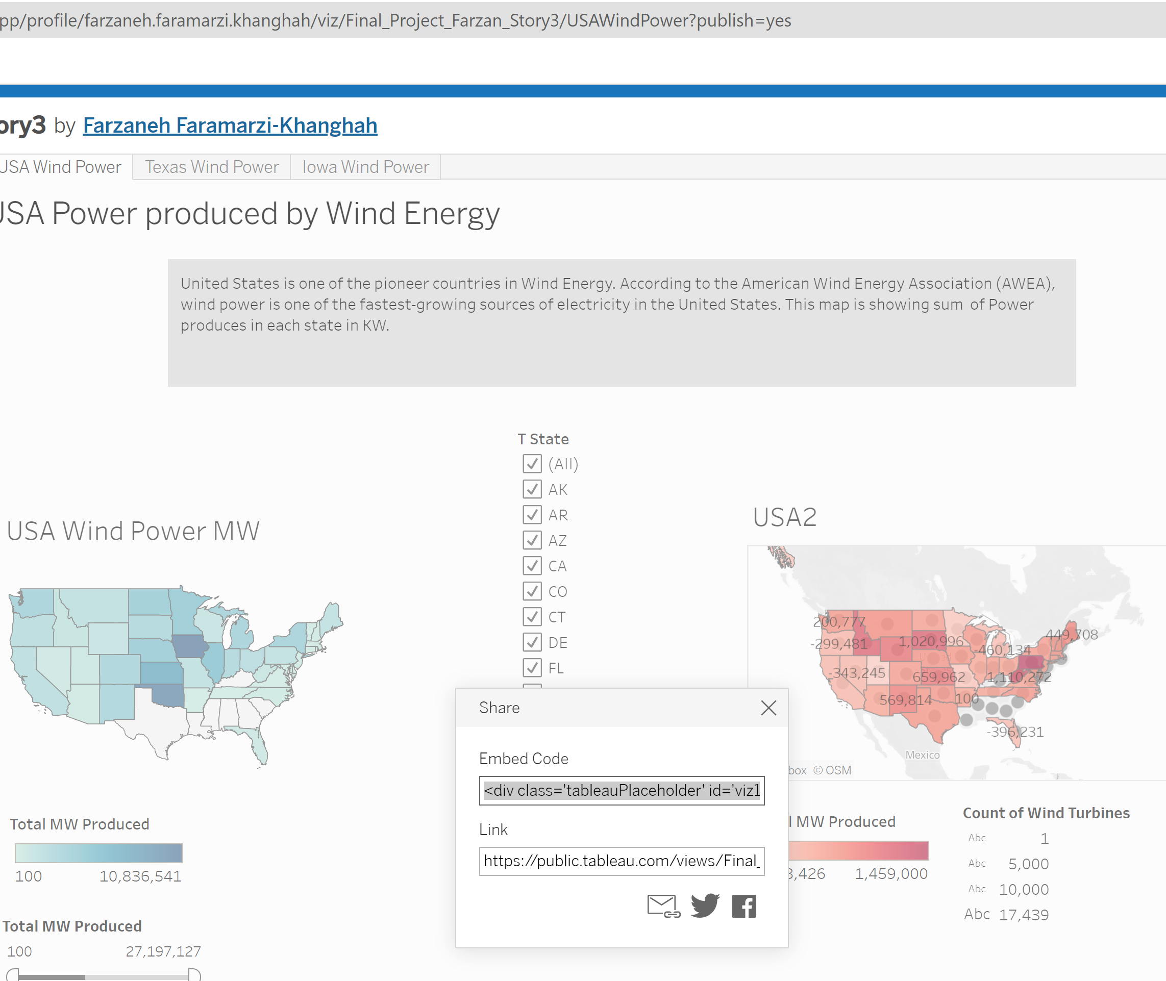
Copy Embed Code from Tableu Public

Slide 15
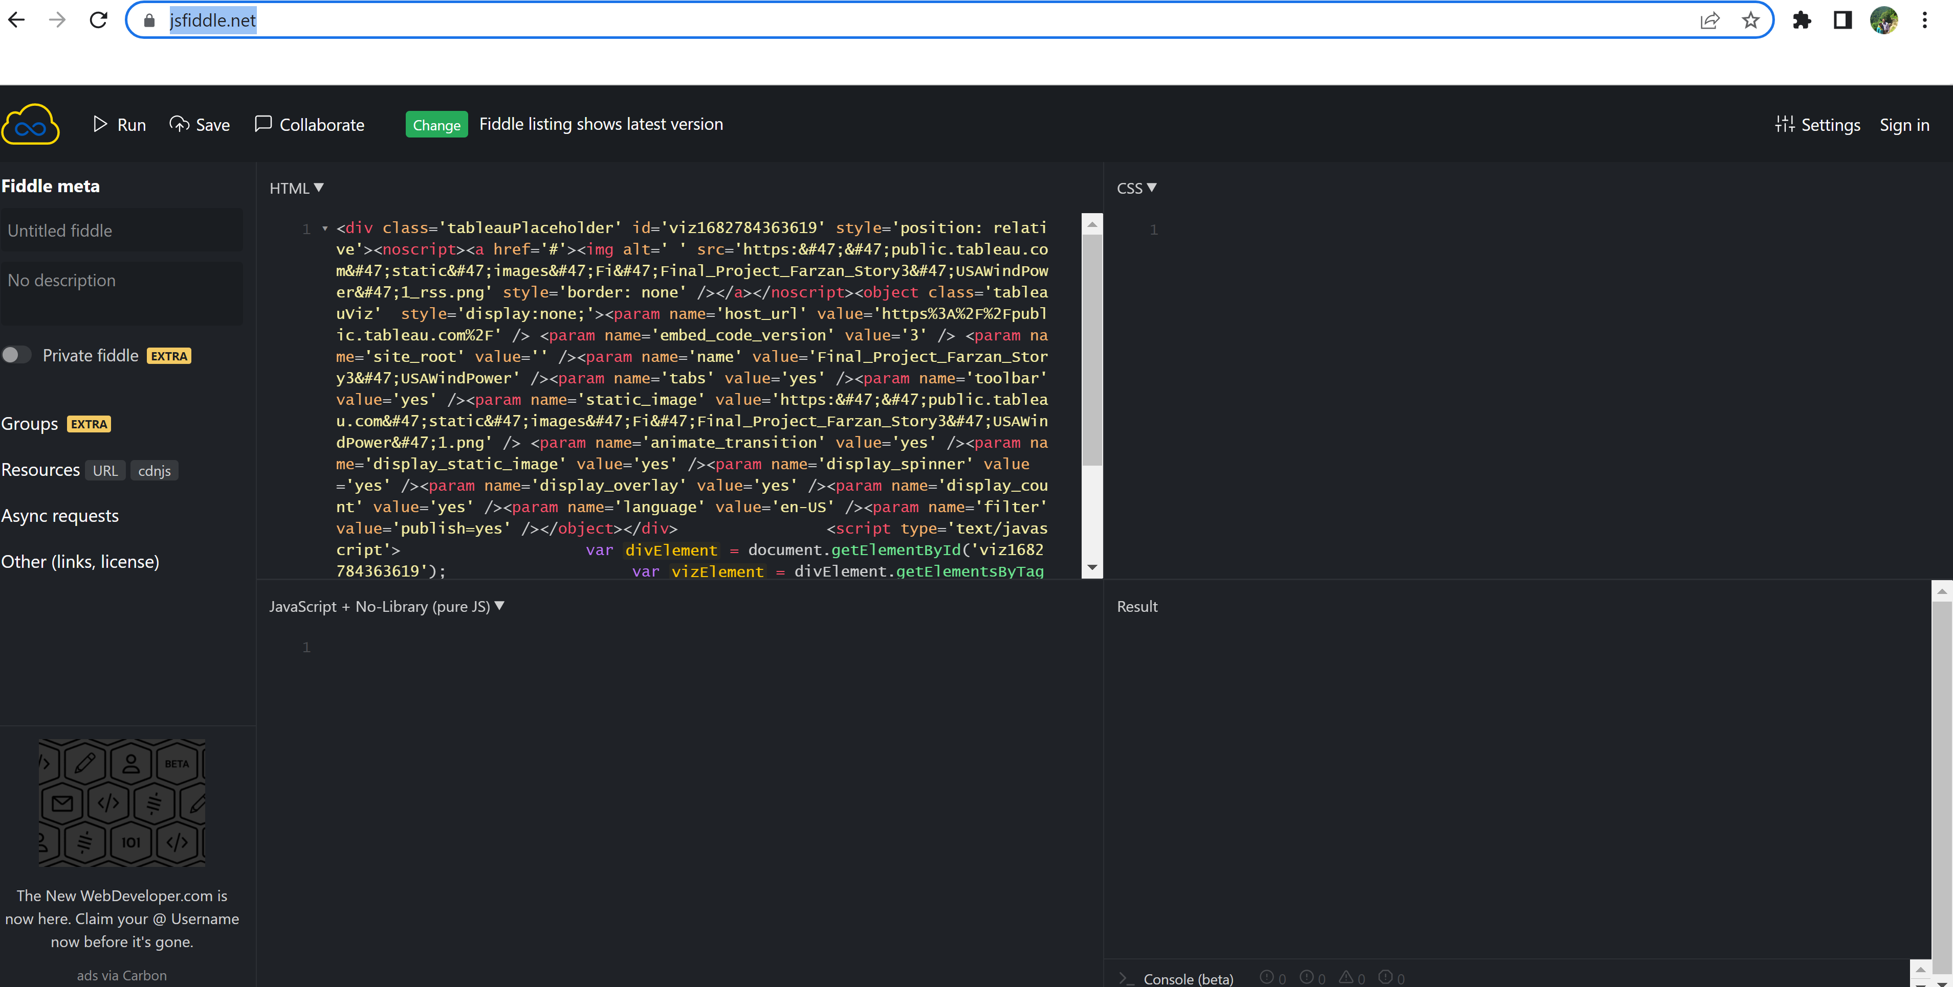
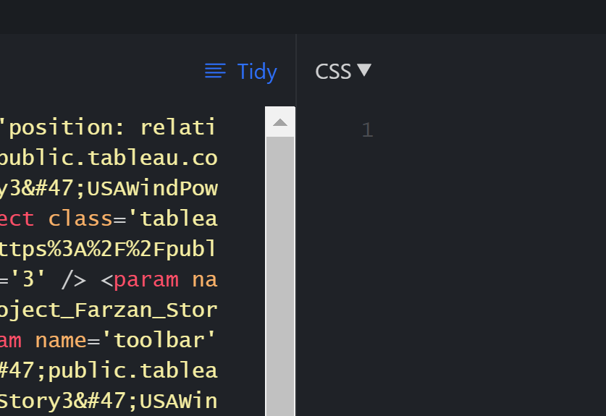
Copy the Embed Code in https://jsfiddle.net/
Copy the Embed Code in https://jsfiddle.net/
And then push the Tidy bottom.
After that Copy the Code, and paste it your html file that you made in GitHub before. Save the HTML file and DONE!

Slide 16
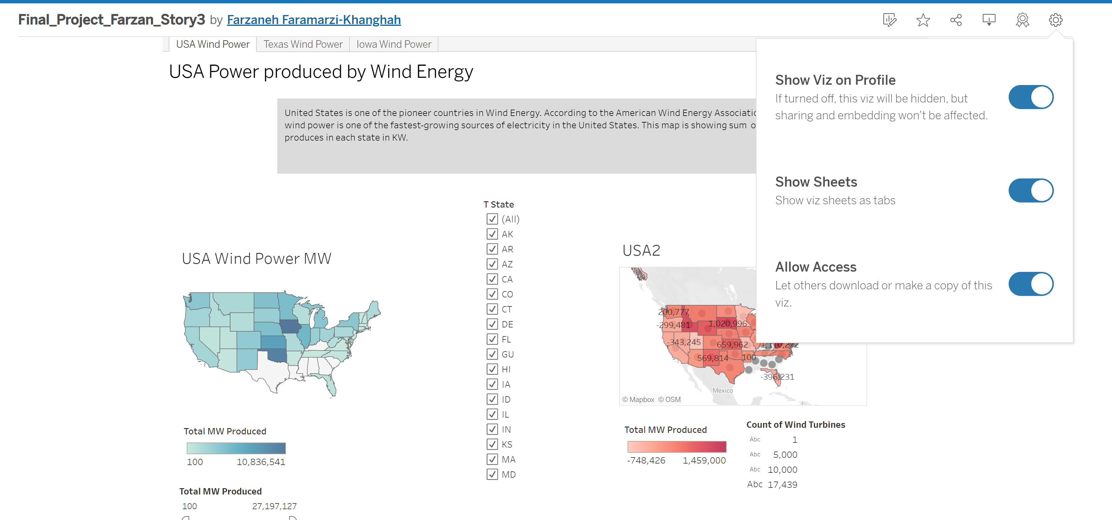
Show All Sheets, Dashboards, Stories
If you have more than one story page go this tab and activate the “Show Sheets”.

Slide 17
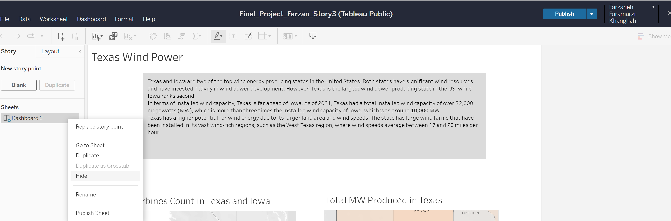
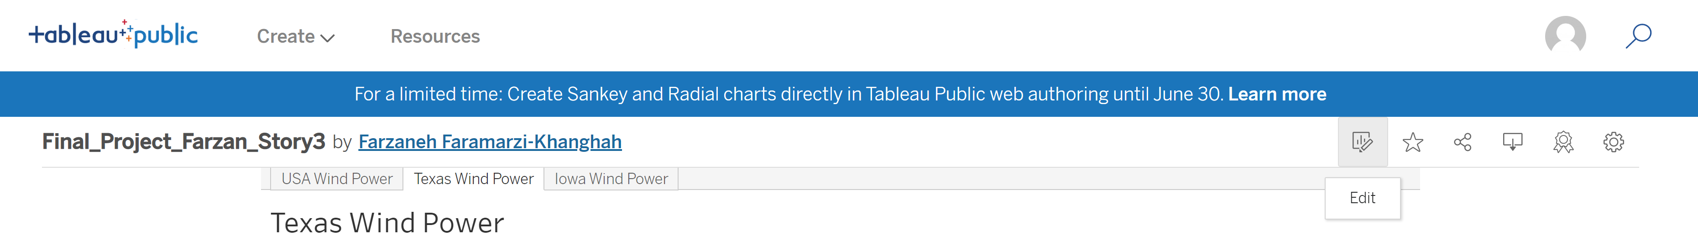
Do not Show some Sheets if you Don’t Want
If you don’t want to show all the sheets, go to the Edit then hide the sheets that you don’t want to show.

Slide 18
